Slide 1
College Board Registration and Online Activity
College Prep
Mr. Gordon

Slide 2
Upcoming Events
Friday, Aug. 27th CRCA Pep Rally
Monday, Sept. 6th Labor Day Holiday
Tuesday, Sept. 7th CRCA Holiday, 10th and 12th still have ACC
Friday, Sept. 17th Student Council Elections

Slide 3
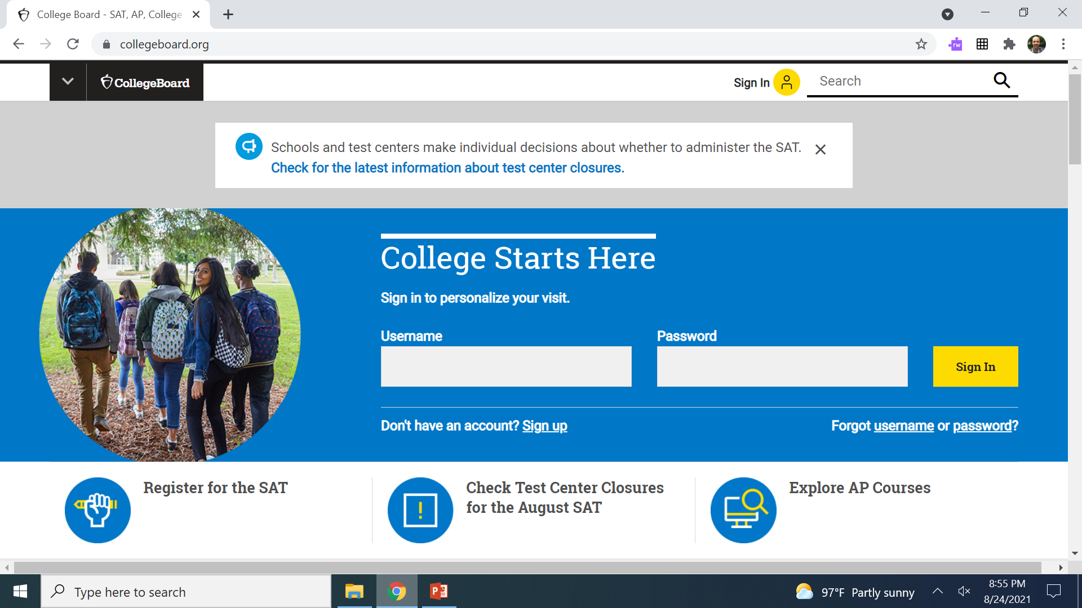
College Board Registration
Go to https://www.collegeboard.org/ and create an account if you do not already have one.
*Keep your username and password. This is a website you will be using for the rest of high school, including signing up for SAT tests and exploring colleges and careers.

Slide 4
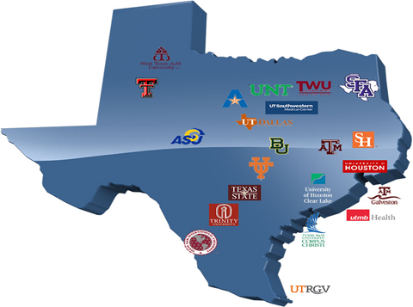
College Board Online Activity
After you have registered, go to https://bigfuture.collegeboard.org/
and follow the instructions on the following slides.

Slide 5

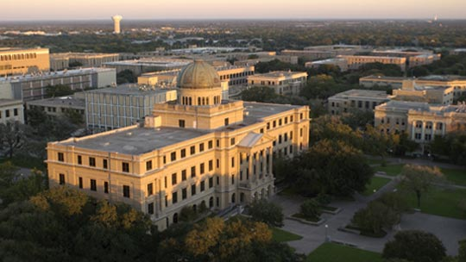
College Board Online Activity
Look up Texas A&M University and answer the following questions:
1. Is this a public or private university?
2. What is the graduation rate?
3. How many total undergrads (students) attend?
4. What is the student-faculty ratio?
5. What percentage of students are majoring in Agriculture?

Slide 6

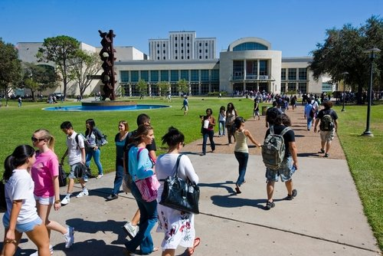
College Board Online Activity
Look up University of Houston and answer the following questions:
1. What is the school’s website?
2. What is the percentage of in-state students?
3. What is the team name or mascot?
4. What is the most popular major?
5. What is the percentage of applicants admitted?

Slide 7
Today’s College Prep Assignment
In the comments section of today’s College Prep, please list the graduation rate for the University of Houston.

